Slide 1


Slide 2

ENTRY FOR 2021-22

Slide 3

Our Vision
Intercultural studies at CUHK
covers topics ranging from Media and Society, Class and Identity, Gender and Queer Studies, Science and Post-humanism, Ecological and Animal rights issues. The program incorporates a variety of perspectives and traditions between disciplines of literary theories, history, philosophy, film studies, critical theories, science and technology. We encourage students to adopt interdisciplinary perspectives to interpret contemporary cultural phenomena and representations.

Slide 4
Our Vision
Students will develop sophisticated understanding of social change and power in everyday life through studying various cultural texts, popular cultural forms, new media and digital practices. It aims to equip students with the analytical skills, critical awareness and sensitivity needed to meet the challenges of a world of increasing divides and conflicts.

Slide 5


Course List (2020-2021)
Core courses:
CULS5301 Concepts of Contemporary Culture
Special electives:
CULS 5201 Basic Issues in Intercultural Studies
CULS 5202 Modern Urbanscape and Asian Culture
CULS 5203 The Body in Culture and Art
CULS 5204 Cultural Studies in Film and Video
CULS 5205 The Culture of Travel and the Travel of Culture
CULS 5206 Gender, Love and Sexuality in Intercultural Studies
CULS 5207 Interdisciplinary Study of Technoscience Culture
CULS 5208 Adaptations, Theatre and Culture
CULS 5209 Special Topics in Intercultural Studies

Slide 6

Course List (2020-2021)
    CULS 5212 Globalization and the Politics of Representation
    CULS 5213 Media and Popular Culture
    CULS 5214 Politics of Cultural Identities
    CULS 5215 MA Research Paper
    CULS 5216 Queer Movements and Sexual Politics
    CULS 5217 Digital Culture and Society
    CULS 5218 Practical and Critical Film Criticism Writing
    CULS 5219 Chinese Society, Culture and Politics
    CULS 5220 Cross-Dressing and Hong Kong Cinema
    CULS 5222 Culture and Politics in the Anthropocene
    CULS 5223 Animals and Society
    CULS5224 Discourse on Hong Kong, Hong Kong Discourse
    CULS 5225 Chinese Independent Film Studies
    CULS 5408 Mass Media and the Transformation of Modern Society
    CULS 5412 Visual Research Methods
    CULS 5413 User-Generated Content & Digital Culture
    CULS5416 Twentieth Century Chinese Visual Arts

Slide 7
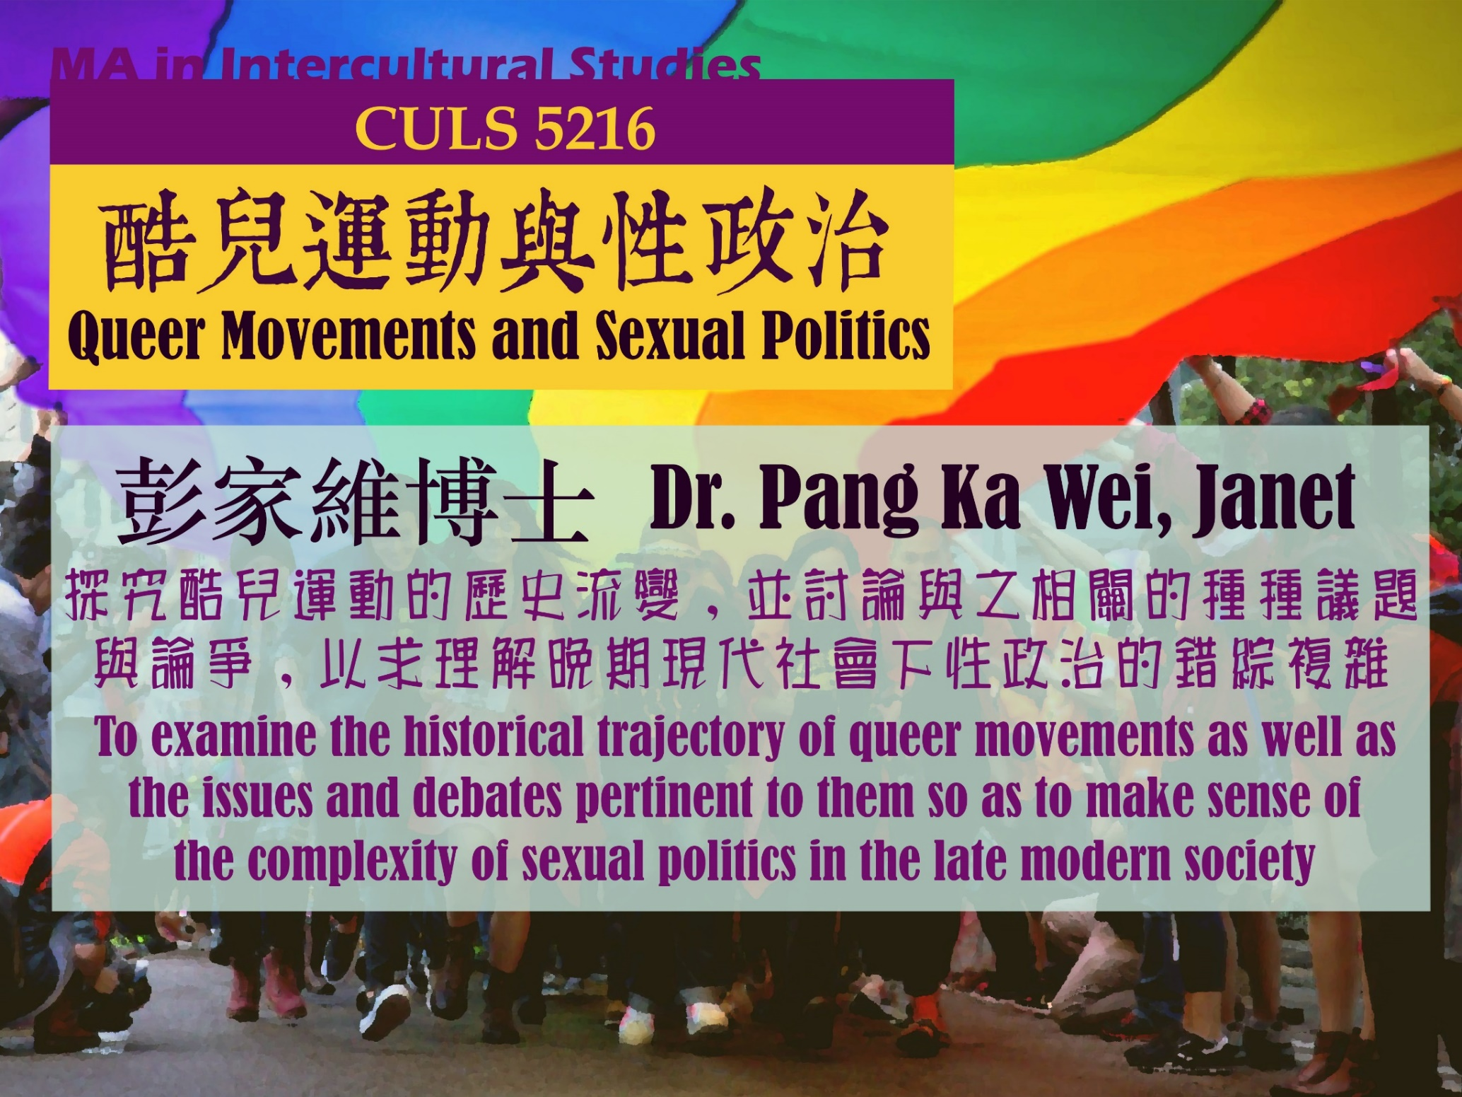
Our world today is shaped by the dominion of images. Recognizing this historic shift, our program has introduced a concentration that will equip students with the critical knowledges and skills to understand the workings and effects of a range of texts and practices from film, visual art, and digital media in China, Taiwan, Hong Kong, and Southeast Asia.
Film & Visual Studies Concentration
    Sample Courses:
    CULS 5204 Cultural Studies of Film and Video
    CULS 5217 Digital Culture and Society
    CULS 5412 Visual Research Methods
    CULS 5416 Twentieth Century Chinese Visual Arts

Slide 8

TEACHERS

Slide 9
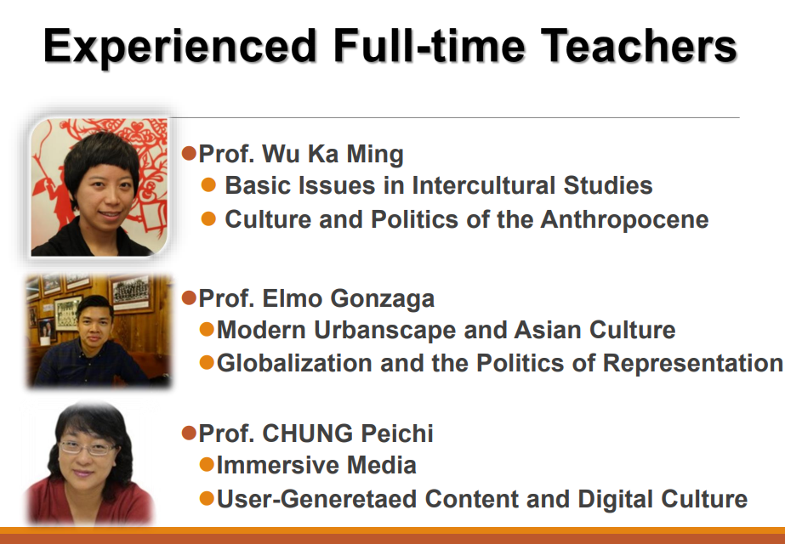

Slide 10
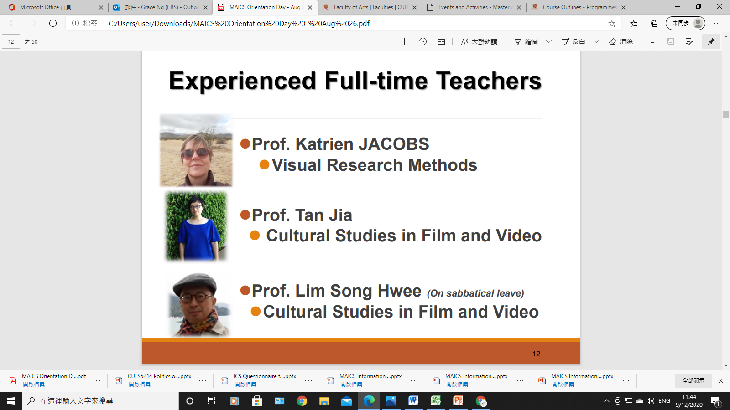
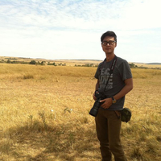
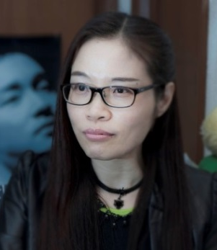
Dedicated Part-time Lecturers
Dr. Chan Ka Ming
Flâneur, Lecturer, Animal-Lover and Film Critic
  Animal and Society
Prof. CHAN Siu Hung Natalia
(Pseudonym: Lok Fung)

Slide 11
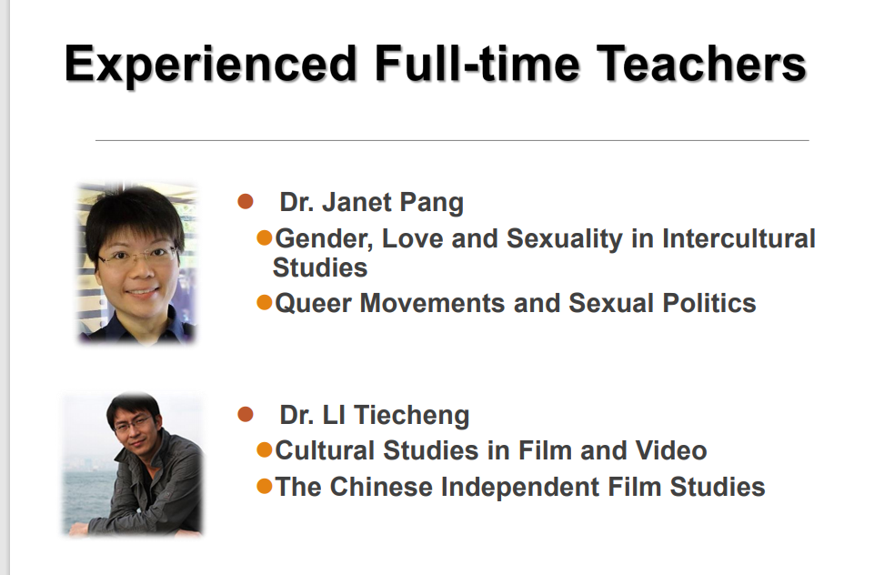

Slide 12
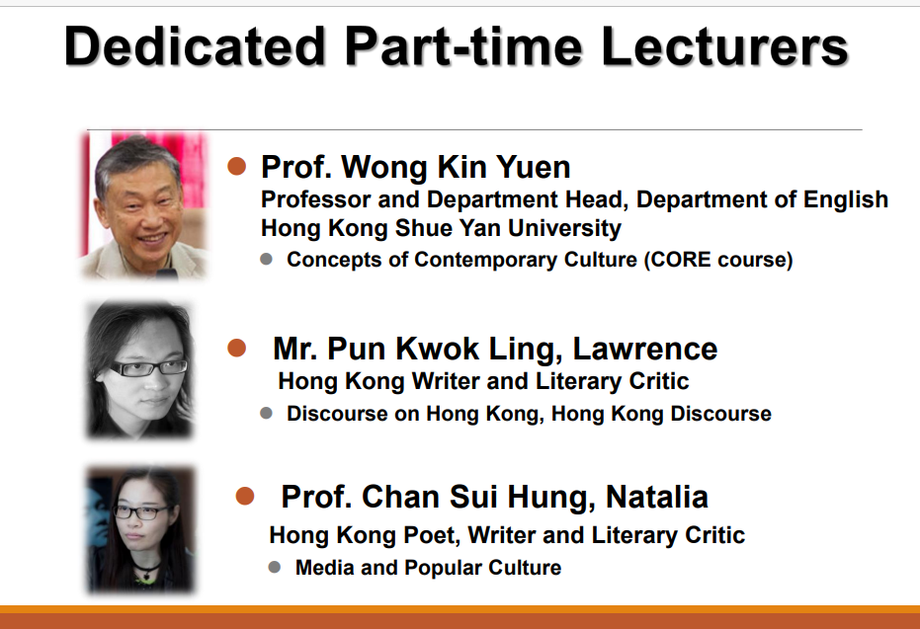

Slide 13
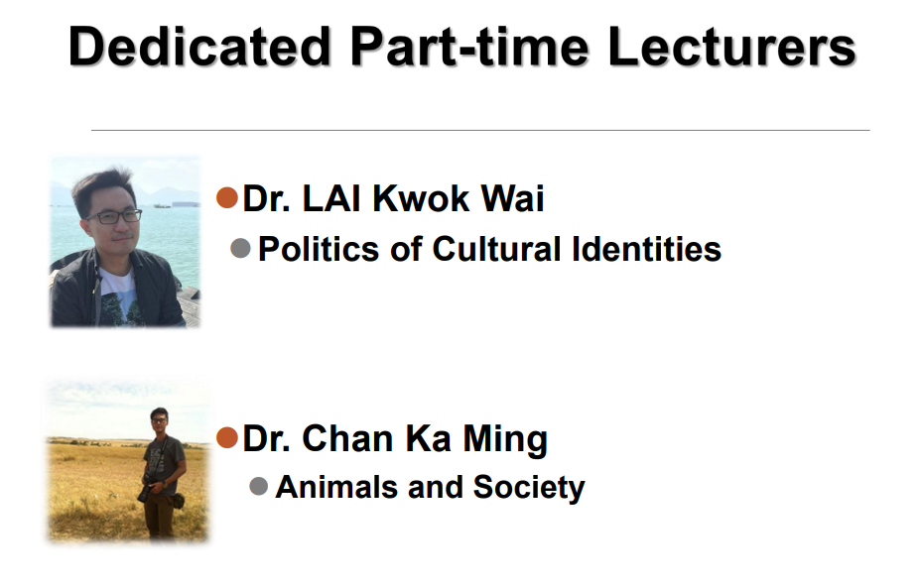
e
e
e

Slide 14

Academic Talk

Slide 15
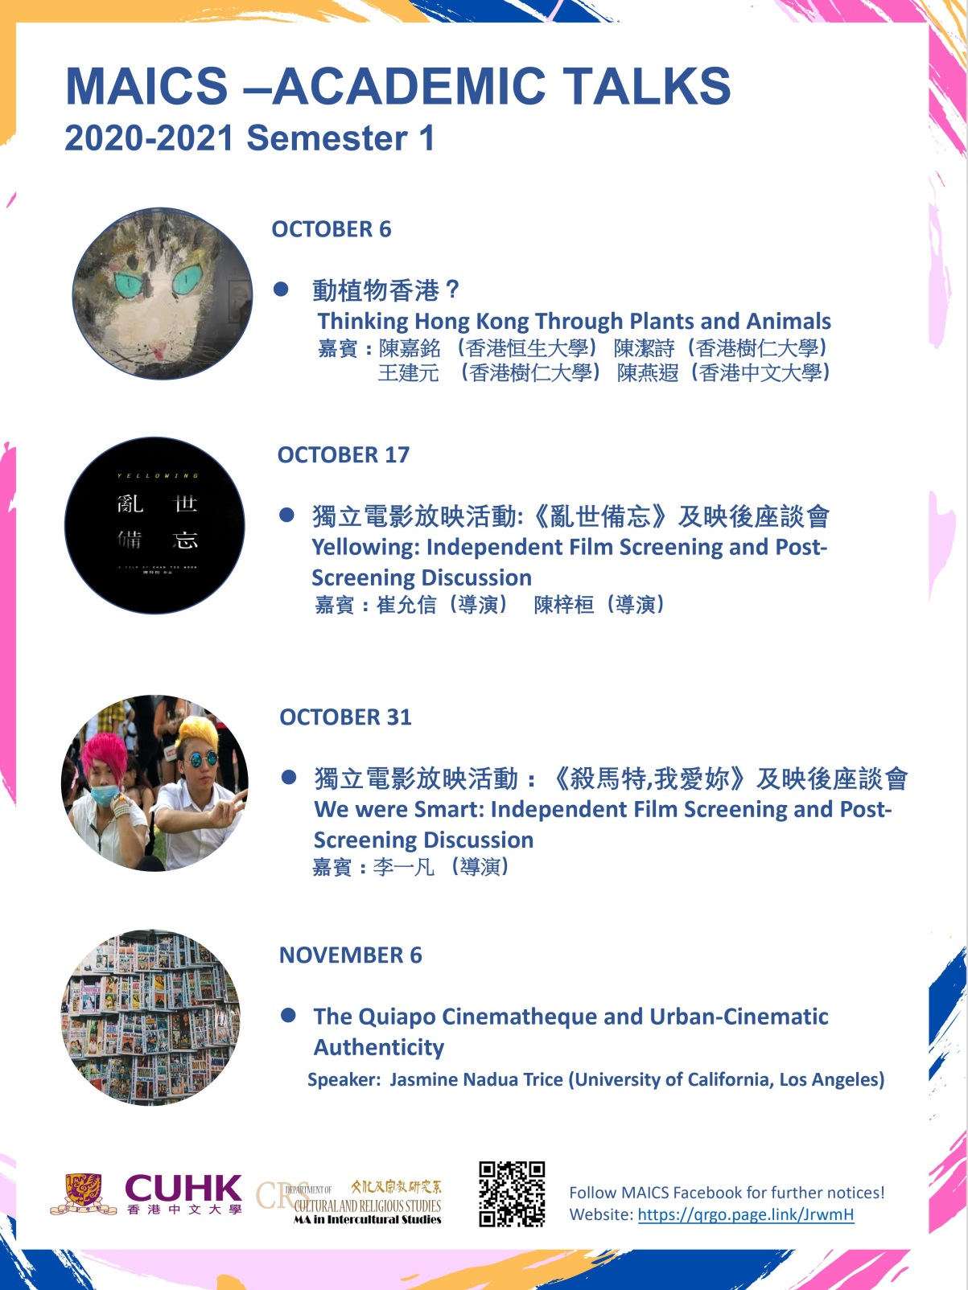

Slide 16

Admission Requirements
A recognized university bachelor degree with honours not lower than Second Class;
A bachelor degree of an honours programme of a recognized university, achieving an average grade of not lower than "B"; or
Professional or similar qualifications from a tertiary educational institution equivalent to an honours degree
For more details, please visit: http://www2.cuhk.edu.hk/gss/entry.php

Slide 17

Tuition Fee in 2021-2022:
$125,000 (Full-time) (normative study period: 1 year)
$ 62,500 (Part-time) (normative study period: 2 years)

Slide 18


Slide 19


Application Deadline
28 Feb 2021

Slide 20
Enquiries
Department website:
http://www.crs.cuhk.edu.hk
Graduate School
Website: http://www.cuhk.edu.hk/gss

